Slide 1

Design Pattern
Search
Observer
Truong Dang Minh Khue

Slide 2
Definition
defines a one-to-many relationship between a set of objects. When the state changes, all of its dependents are notified.
Observer Pattern

Slide 3

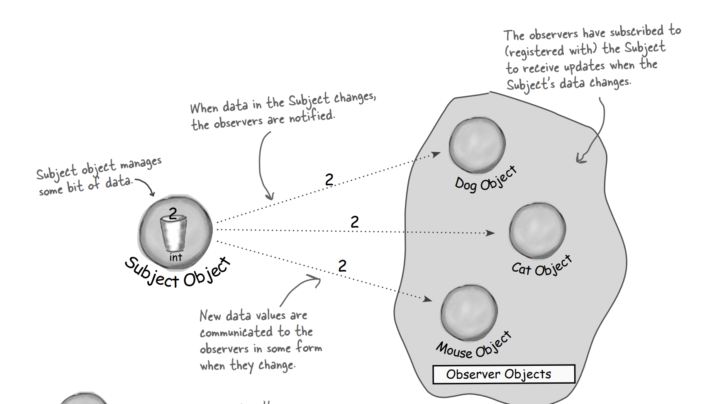


Slide 4
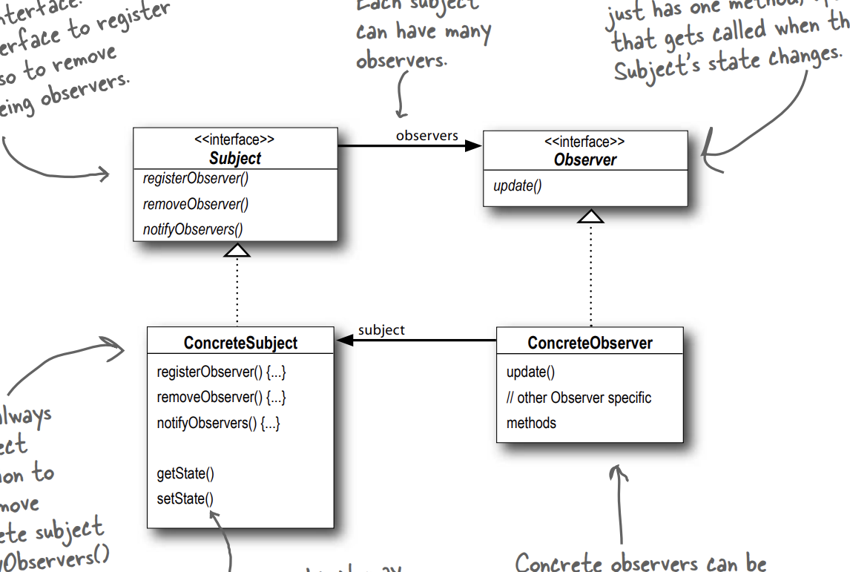

Slide 5
Definition
Allows us to build flexible OO systems that can handle change as they minimize the interdependency
Loosely
Coupled Priciple

Slide 6
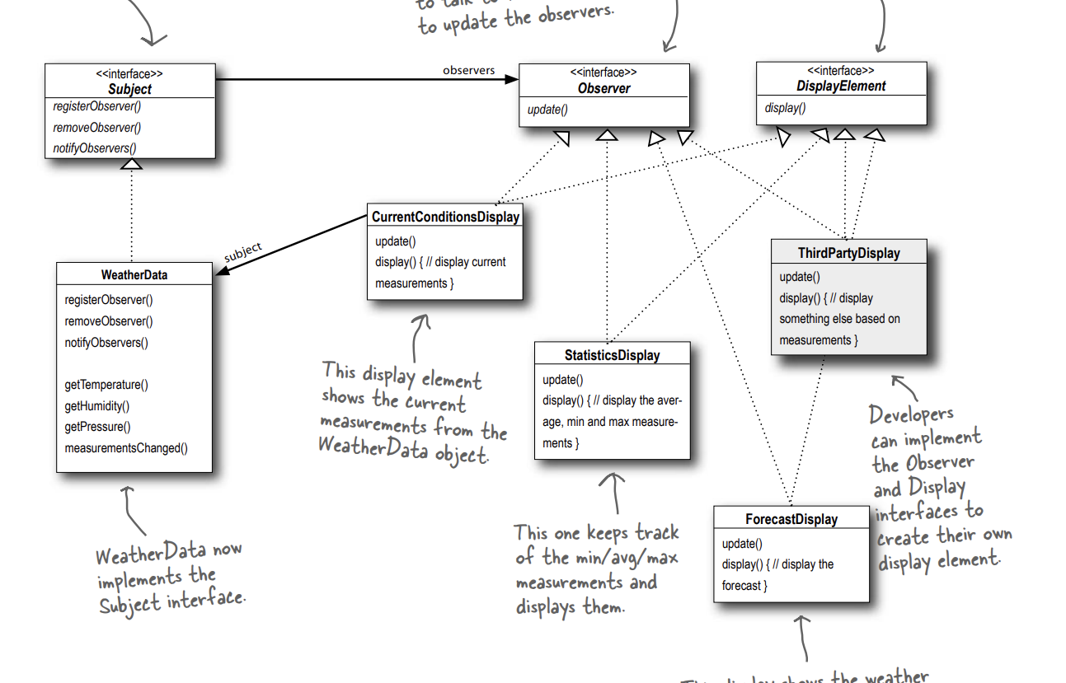

Slide 7
Thank you!
Until our next design pattern!

